Slide 1
AGORA: Automated Generation of Test Oracles for REST APIs
Enhancing API Testing Through Invariant Detection
Group 6 - Abhishek Manyam, Anushka Jain, Rishitha Pokalkar
Notes:
Good Afternoon, everyone. Today, we embark on a journey into the evolving landscape of API testing, where the demand for precision and robustness is ever-growing. The realm of test case generation tools for REST APIs has witnessed a surge in both number and complexity. However, an intriguing paradox emerges — while these tools showcase advanced capabilities in automated input generation, their test oracles often exhibit a surprising simplicity. This simplicity, unfortunately, limits the types of failures they can effectively detect to mere crashes, regressions, and violations of the API specification. In response to this challenge, we present AGORA — an innovative approach that takes API testing to new heights by focusing on the automated generation of test oracles. AGORA's uniqueness lies in its ability to detect invariants, properties of the output that should always hold. In today's presentation me and my group members will dive you into the world of AGORA and goals.

Slide 2
Let's unravel the essence of AGORA
AGORA isn't just another acronym, it represents a paradigm shift in how we approach API testing.
At its core, AGORA is designed to automate the generation of test oracles for REST APIs. But what sets AGORA apart is its method
— it achieves this through the detection of invariants.
Notes:
The primary goal of AGORA is to automate the generation of test oracles for REST APIs by detecting invariants, which are properties of the output that should always hold. This is achieved by analyzing previous API requests and their corresponding responses to learn the expected behavior of the API. AGORA aims to address the limitations of existing test oracles, which primarily focus on detecting API crashes, regressions, and violations of the API specification or design best practices. By extending the Daikon tool for dynamic detection of likely invariants and implementing an instrumenter called Beet, AGORA can detect different types of invariants in REST APIs. The approach has shown promising results in detecting errors and bugs in industrial APIs, including those with millions of users, such as Amadeus, GitHub, Marvel, OMDb, and YouTube.

Slide 3
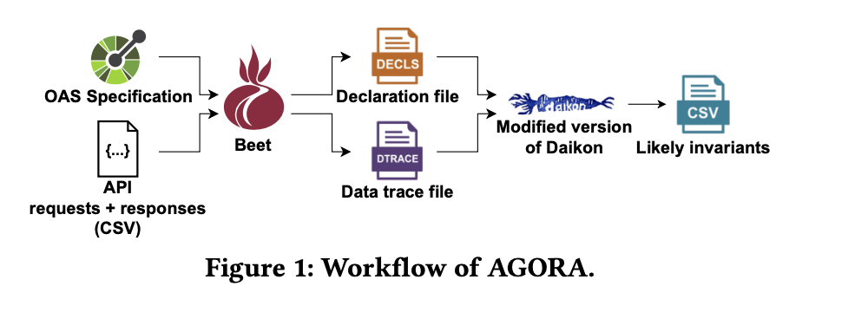
What are invariants?
Think of them as the fundamental truths that should always hold in the output of an API, regardless of its complexity.
OAS - OpenAPI Specification
Beet
Daikon
Notes:
What are invariants… as we all know fundamental truths that should always hold in the output. So here we have a workflow model of AGORA. The core of the approach is Beet, a novel Daikon instrumenter, which receives three inputs: the OAS specification of the API under test, a set of API requests, and the corresponding API responses and it returns an instrumentation of the API requests, consisting of a declaration file describing the format of the API operations' inputs and outputs, and a data trace file specifying the values assigned to each input parameter and response field in each API call.
The instrumentation generated by Beet is then processed by a customized version of Daikon, resulting in a set of likely invariants that can be used as test oracles once confirmed by developers.
OAS, or OpenAPI Specification, is a widely used standard for describing RESTful APIs. It provides a clear, language-agnostic way to describe both the structure and behavior of these APIs.

Slide 4
What does this mean for API testing?
Supporting the detection of up to 105 different types of invariants in REST APIs.
Enhanced Accuracy and Efficiency
Scalability in Testing
Dynamic Invariant Detection
Notes:
AGORA stands out by supporting the detection of up to 105 different types of invariants in REST APIs. It's not just about identifying crashes or regressions; AGORA goes beyond, providing a comprehensive lens to scrutinize API behavior.
1.Enhanced Accuracy and Efficiency: Since AGORA uses dynamic invariant detection to understand expected API behaviors, it reduces the likelihood of human error and increases the thoroughness of the testing.
2.With the automation provided by AGORA, it becomes feasible to scale API testing efforts. Companies and developers can handle larger numbers of APIs or more complex APIs without a proportional increase in the manual effort required for testing.
3.AGORA's use of dynamic invariant detection, which involves observing the behavior of an API during runtime to infer correct behavior. This approach can detect subtle bugs and issues that might be missed by traditional testing methods.

Slide 5
Objective
Verifying results
Making sure if the results from the paper match when the same or similar dataset is used.
Testing under different conditions
Testing AGORA on different datasets. The goal is to verify if the desired output is similar to the yielded result.
Notes:
There are 2 objectives in our Replication study
If not - report out findings in the study.

Slide 6
We aim to answer the following research questions:
How effective is AGORA in generating test oracles?
What is the impact of the size of the input data set on the precision of AGORA?
We aim to measure the precision of AGORA in generating invariants that result in valid test oracles (i.e., they properly model the expected API behavior) using the default configuration of Daikon as a baseline.
The precision of the detected invariants usually depends on the quality and diversity the input datasets (i.e., API requests and responses). Hence, we aim to study the impact of data set size on the effectiveness of AGORA.
Notes:
Research questions we aim to test that are answered in this paper
AGORA’s performance in generating valid test oracles will be compared against the results achieved by Daikon under its standard settings.
Comparing that with the base configuration of Daikon
How datasets effects the precision of agora

Slide 7
Continue…
How effective are the generated test oracles in detecting failures?
The final goal is generating test oracles that can be used during testing to identify erroneous responses caused by faults. Thus, we aim to investigate the effectiveness of the generated oracles for detecting non-trivial failures in REST APIs.
Notes:
The primary purpose of these automatically generated test oracles is to identify incorrect responses from the API during testing.
The study isn't just about creating these test oracles; it's also about rigorously investigating and evaluating how good they are at catching these non-trivial failures. This involves assessing their accuracy, reliability, and efficiency in a real-world testing environment.

Slide 8
How we will accomplish our goal
Learning Expected Behavior.
Extension of Daikon.
Instrumentation with Beet.
Diverse Invariant Detection- For other dataset.
Notes:
We will begin by analyzing previous API requests and their corresponding responses. This learning phase is crucial as it forms the foundation for understanding the expected behavior of the API.
AGORA leverages Daikon, a dynamic detection tool for likely invariants. So we will extended Daikon's capabilities to enable the identification of a diverse range of invariants in API outputs.
Then we will enter Beet, our instrumenter, which plays a pivotal role in AGORA's functionality. (optional- Beet converts any OpenAPI specification and a collection of API requests and responses into a format that Daikon can process.)
After applying AGORA on familiar dataset we will use other diverse dataset and will compare the results.

Slide 9
PLAN OF ACTION
Methodology and Data Preparation - week 1 - Abhishek
Role: Establishing and refining the methodology to be used in the replication study.
Tasks:
Literature Review & Project Familiarization
Review the original methodology used in the AGORA study and identify any potential adjustments for replication.
Select and prepare the datasets needed for testing, ensuring they are comparable to those used in the original study or suitably diverse for extended analysis.

Slide 10
PLAN OF ACTION
Testing and Analysis - week 2-4 - Anushka
Role: Conducting tests and analyzing the results.
Tasks:
Set up the testing environment, ensuring it matches the conditions of the original study as closely as possible.
Run the tests using AGORA on the selected datasets.
Analyze the results, comparing them to the findings of the original study and noting any deviations or new insights.

Slide 11
PLAN OF ACTION
Documentation and Review - week 5 - Rishitha
Role: Documenting the study process and outcomes, and conducting a thorough review.
Tasks:
Document each step of the replication process, including methodology adjustments, testing setups, and analysis findings.
Prepare the final report and presentation, ensuring they are comprehensive and clear.
Review the entire replication study, checking for consistency and completeness.

Slide 12
THANK YOU

